Slide 1
OBJECT ORIENTED PROGRAMMING PROJECT:
FAST BANK MANAGEMENT SYSTEM

Slide 2
NAME:
Muhammad Anas Hassan (20K-1726)

Slide 3

AIM AND MOTIVATION:
Our goal, aim and motivations is to develop a powerful software for solving all the basic necessities and financial applications of a customer in banking environment in order to nurture the needs of an end banking user by providing various ways to perform banking tasks to ensure smooth operation and tasks as well as keep the information of the employees and their salary.
Nowadays, managing a bank is a tedious job upto certain limit. So, software that reduces the work is essential. Also, today’s world is a genuine computer world and is getting faster day-by-day. Thus considering above necessities, bank management software is become necessary which would be useful in managing bank services more efficiently. Our software will perform and fulfill all the tasks that any customer would desire.

Slide 4


IDE USED FOR PROJECT:
We develop this powerful bank management system software in C++ language by working on Dev-C++ and Visual Studio Code IDE. We used these IDE because lightning fast source code editor, perfect for day-to-day use which inspire/attract the user. Also, we will also provide friendly and colorful environment with the help of some graphics to the customer in order to access the software.

Slide 5
CLASS DIAGRAM (MODEL):
FAST BANK
=> BASE CLASS
PERSON
CUSTOMER
EMPLOYEE
ACCOUNT
EMPLOYEE TYPE
MANAGER
=> MANAGER CLASS HAS BEEN DECLARED FRIEND OF ALL CLASSES PRESENT IN THE CLASS DIAGRAM (MODEL)

Slide 6
FEATURES:
The Home Page module, represents the whole system of banking.
The Login module, represents how a new user enter the banking application and doing their transaction details.
The Open Account module, allows the user to create the new account of customer.
In the Deposit Amount module, customers can deposit specific amount in their accounts.
In the Withdraw Amount module, customers can withdraw specific amount in their accounts.
The Display All Account module, displays all the account information.
The Delete Account module, deletes or closes the accounts of the customers.
The Logout module, represents the logout of the whole banking system.

Slide 7
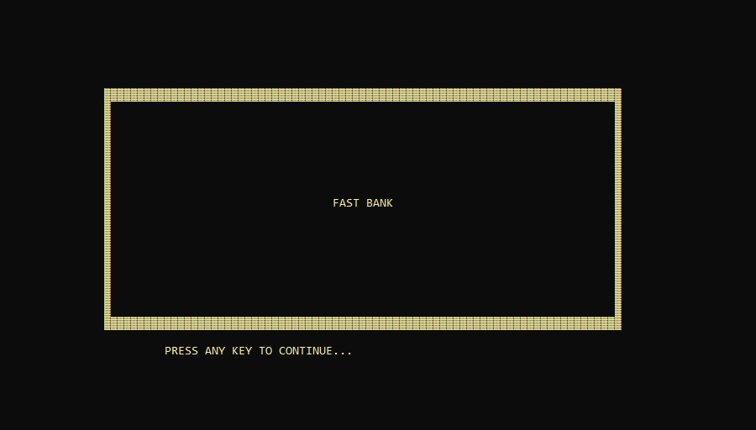
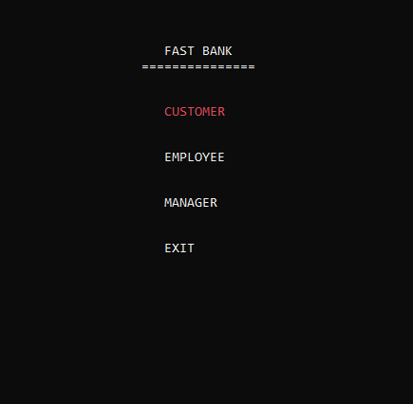
Console screenshots:
Actors/System users in Bank management system are Customer, Employee and Manager

Slide 8
THANK YOU…

